Slide 1
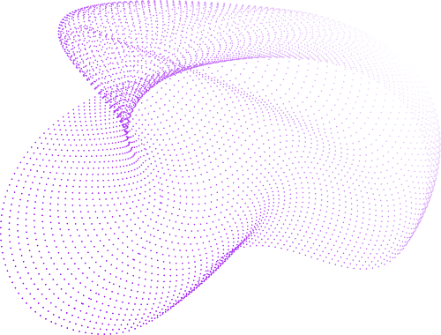

Awake Assist
Detection of Driver Drowsiness | Computer Vision

Slide 2
Agenda:
1- Problem Statement & Solution
7- Results
2- Solution Architecture
8- Model Evaluation
3- Data Collection
9- Challenges
4- Data Preprocessing & Augmentation
10- Future Work
5- Tools
6- Model Development & Training

Slide 3
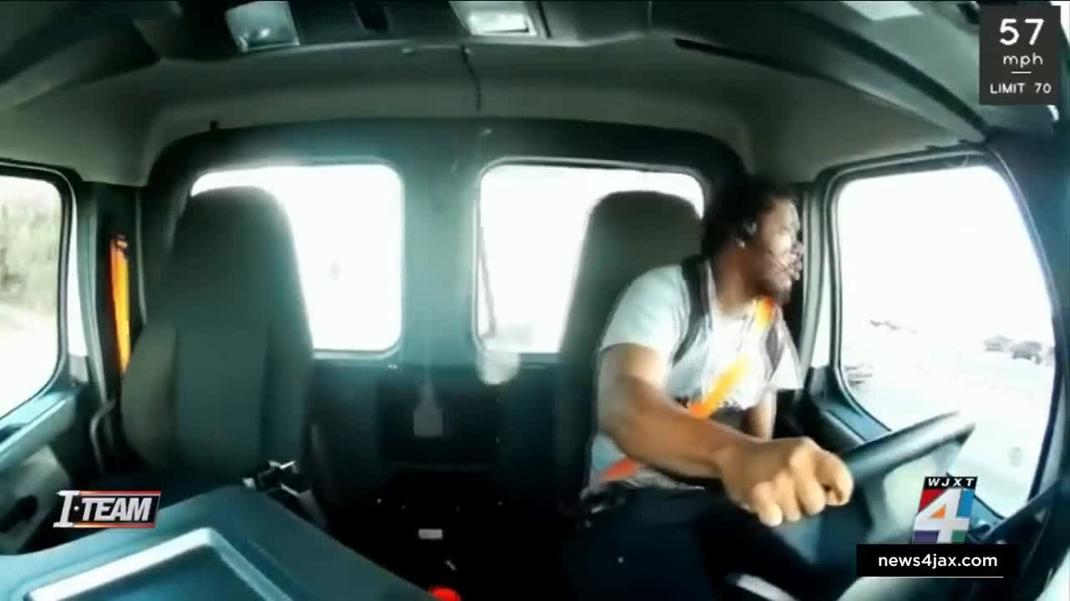
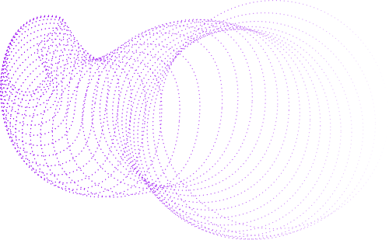
Problem Statement & Solution:

Slide 4
Problem Statement & Solution:
Driver drowsiness is a significant factor contributing to road accidents, which can lead to traffic congestion and other related problems. This project aims to develop a real-time, non-intrusive driver drowsiness detection system using an object detection model. The system will continuously monitor drivers' facial expressions, classified as yawning, sleep, or normal, to detect drowsiness. In addition, an alert feature will be integrated to immediately wake the driver when sleep is detected, reducing the risk of accidents and minimizing the impact on traffic flow. The project aligns with Saudi Vision 2030 by promoting road safety and reducing crowded roads.

Slide 5
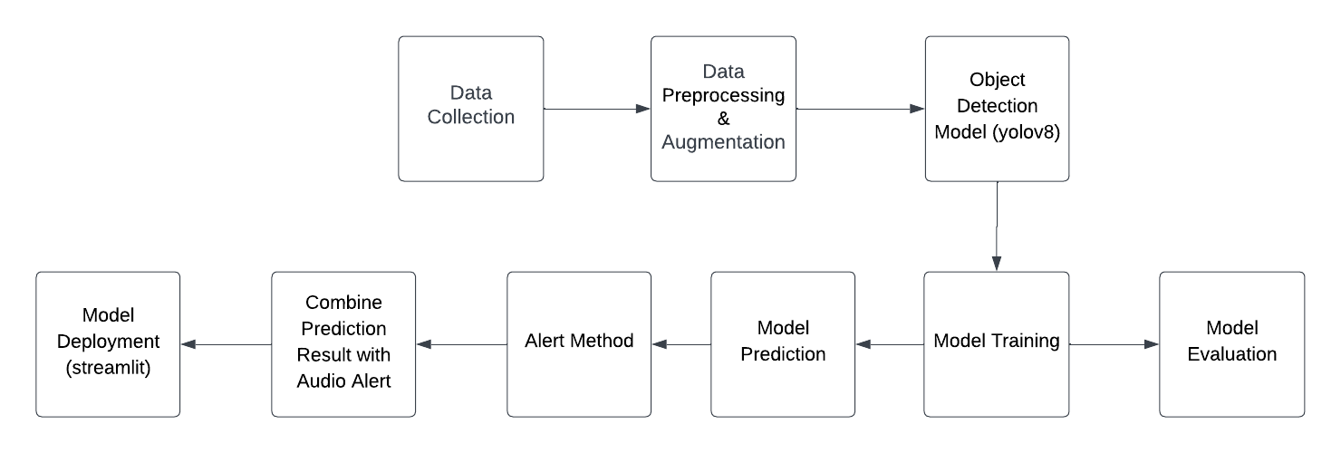
Solution Architecture:

Slide 6



Data Collection:
Data were collected from Kaggle and Roboflow and processed using Roboflow .
Data source
processed by

Slide 7
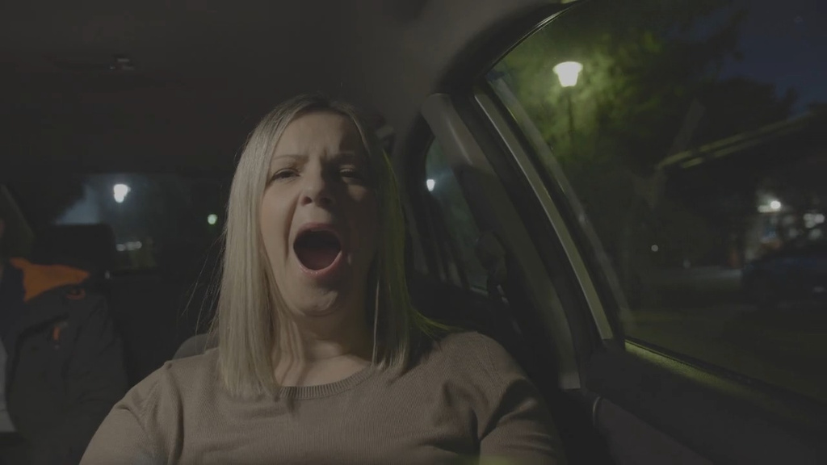
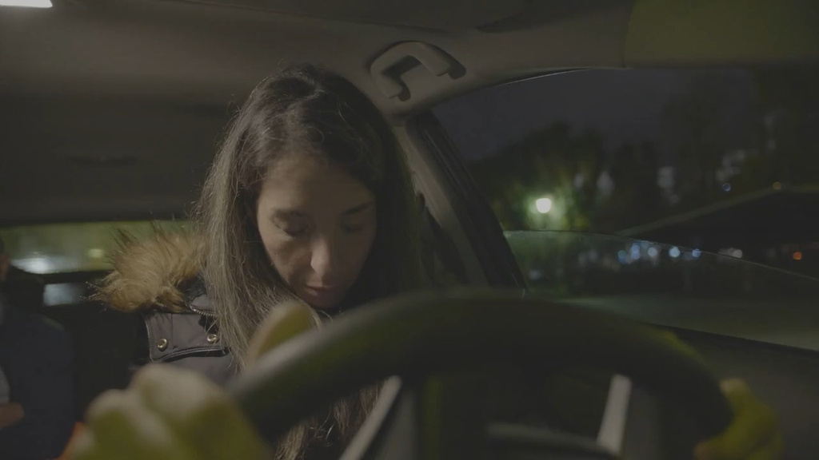

Sample of Data:
Yawning
Sleep
Normal

Slide 8
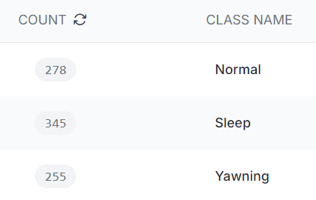
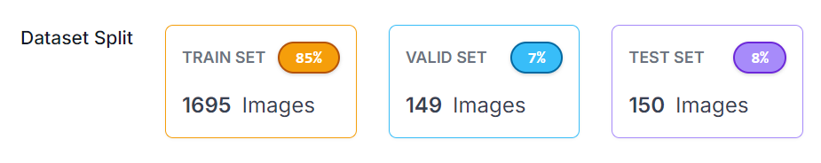
Data Preprocessing & Augmentation:
3 classes
Total images: 1994

Slide 9
Data Preprocessing & Augmentation:
Augmentation | Preprocessing
Brightness | Auto-Adjust Contrast
Noise | Grayscale
90° Rotate | Resize

Slide 10
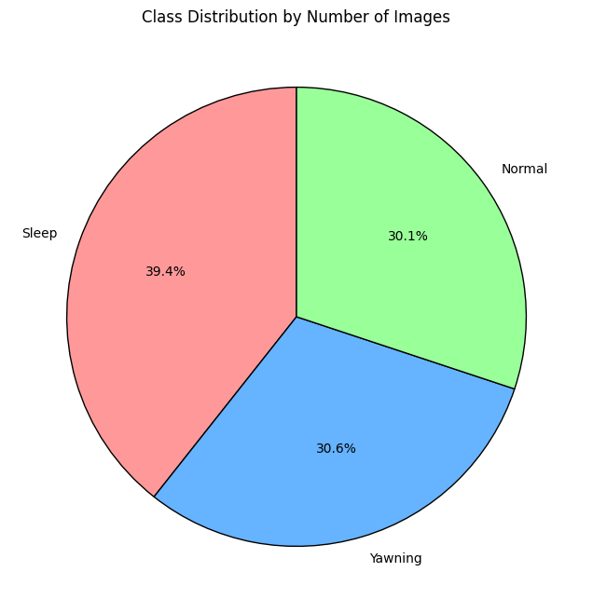
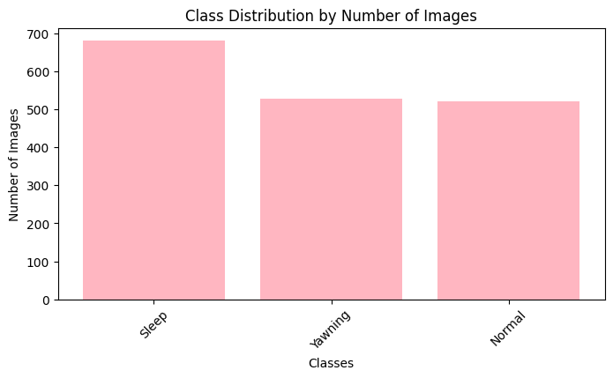
Data Visualization:

Slide 11





Tools:
Google Colab
OpenCV
Ultralytics
IPython
Streamlit

Slide 12
Model Development & Training:
Task | Model | Epoches | Imgsz
Detect | yolov8 | 30 | 640

Slide 13
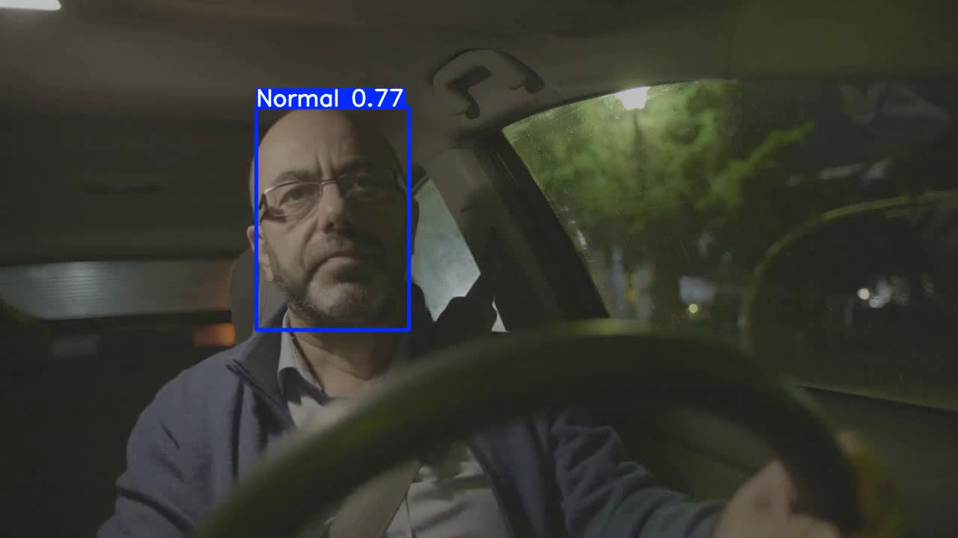
Results:

Slide 14
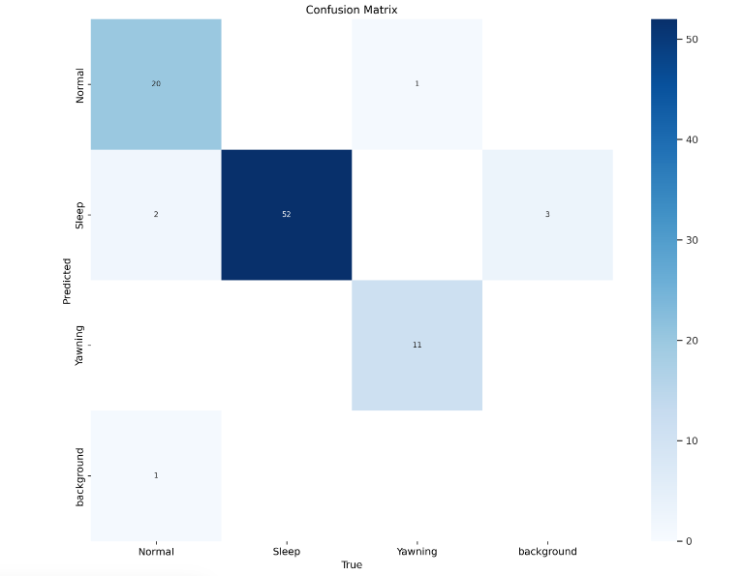
Model Evaluation:
mAP | mAP | mAP
Normal | Sleep | Yawning
0.87 | 0.96 | 0.91

Slide 15
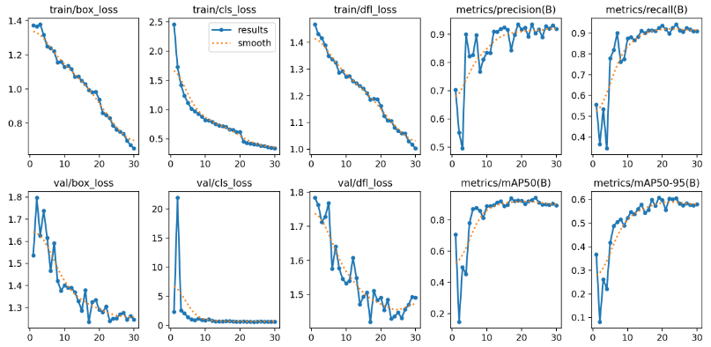
Model Evaluation:

Slide 16
Challenges:
Environmental Variations: Lighting, head position, and occlusions (e.g., sunglasses) may affect detection performance.
Real-Time Processing: Ensuring smooth, real-time detection and alarm integration.
Data Collection & Labeling: Gatheringand finding a diverse dataset, and manual labelling for the three classes.

Slide 17
Future Work:
When the driver sleep, alert will be played. while in the future when yawning detected a method will be added to interact with driver to make them focus before driver falling to sleep.
More features will be added (phone, safety belt).
When the driver is detected to be asleep, the brakes automatically stop.
Improve model performance.

Slide 18
Thank you for listening!
Team Members: Sarah Aljuwayr - Aliah Alotaibi - Najla Aldhubaib

